Slide 1

Presentation
On
“Database Management Systems"
Shirpur Education Society's
R. C. Patel Institute of Technology, Shirpur
An Autonomous Institute
Submitted by
Bhuvanesh Suryakant Neve
Tushar Dilip Sonawane
Darshan Pravin Mali
Niraj Manoj Mahajan
S.Y.(Computer)/2024-2025/PRN NO:- 231101190
Under The Guidance of
Prof. S.B Raghuwanshi
R. C. Patel Institute of Technology, Shirpur

Slide 2
Outline
Introduction
Key Features of DBMS
Advantages of DBMS
Components of DBMS
Examples of Relational Database
Limitations of Traditional File Systems
DBMS vs Traditional File System
Conclusion

Slide 3




Introduction
What is a DBMS ?
A Database Management System (DBMS) is software used to create, manage, and control databases.
It allows data to be stored, retrieved, and updated efficiently.
Common types of DBMS: Hierarchical, Network, and Relational (RDBMS).
Example: MySQL, Oracle, Microsoft SQL Server.

Slide 4


Key Features Of DBMS
Data Redundancy Control: Minimizes the duplication of data, ensuring efficient use of storage.
Data Integrity: Maintains data accuracy and consistency over its lifecycle.
Data Security: Provides access control to ensure that only authorized users can access or modify data.
Data Sharing: Multiple users can access the same data simultaneously without conflict.
Backup and Recovery: Automates the process of creating backups and recovering data after crashes or losses.

Slide 5
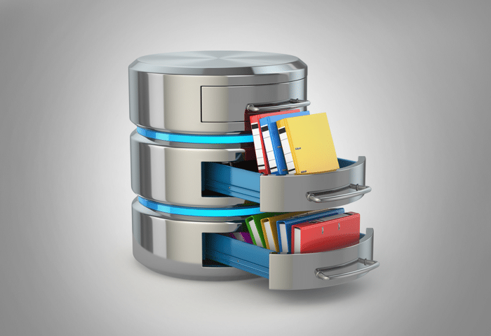
Advantages Of DBMS
Data Organization: Organizes large volumes of structured and unstructured data efficiently.
Relational Data Handling: Manages complex relationships between different data items, improving flexibility.
Improved Performance: Enhances the speed and efficiency of data retrieval and updates.
Centralized Data Control: Ensures better control over data access, updates, and security by centralizing management.

Slide 6

Components Of DBMS
Data Dictionary: Holds metadata, such as structure definitions and constraints for the data stored.
Data Definition Language (DDL): Defines the database schema, structures like tables, indexes, etc.
Data Manipulation Language (DML): Provides tools to query, insert, update, and delete data from the database.
SQL (Structured Query Language): The standard language for interacting with relational databases, used to create, manipulate, and query data.

Slide 7

Example Of Relational Database
Customer Table: Stores customer details like Customer ID, Name, and Address.
Orders Table: Contains order information like Order ID, Customer ID, Product, and Price.
Join Example: The Customer ID field links customer and order data, enabling retrieval of orders for a specific customer.

Slide 8
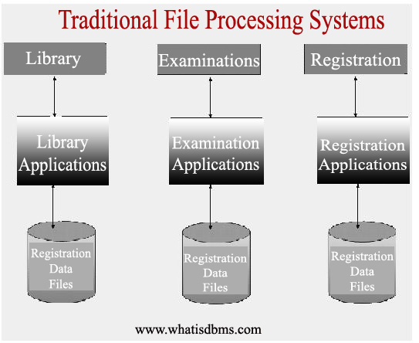
Limitations Of Traditional File Systems
Redundancy: Multiple copies of the same data across different files, leading to inefficiency.
Lack of Security: Traditional file systems do not provide centralized access control, making data vulnerable.
Slow Access: Searching for specific data across many different files can be time-consuming and inefficient.
Data Isolation: Data stored in different files may not be easily accessible or integrated, making it hard to retrieve related data.

Slide 9

DBMS vs Traditional File System
DBMS: Provides a centralized and structured way to store data, reducing redundancy and improving security.
Traditional File Systems: Often suffer from inefficiency, scattered data storage, and lack of data integration, making management difficult as the amount of data grows.

Slide 10
Conclusion
A DBMS is a powerful tool for managing large sets of data in modern information systems.
It ensures that data is easily accessible, secure, and managed in an organized way.
With growing data needs in industries like healthcare, finance, and e-commerce, DBMS solutions are essential for efficiency and productivity.

